Slide 1
Vipassana Meditation

Slide 2
Vipassana
Written by Buddhghosa in around 500 CE.
Has been used as a manual by meditation teachers for 1500 years.
His ideas have been used for what is known as Vipassana Meditation. This focuses on the mind.
Vipassana mediation is often called ‘insight meditation’, and it is the second main type of meditation practised in Theravada Buddhism and often a key focus of Mahayana and Zen Buddhism.
The idea of this type of mediation is to try to gain insight into the true nature of reality – to see things as they really are.
It may consist of reflecting on the three marks of existence: that all experience is characterised by impermanence that nothing has an independent, unchanging identity, and that attachment leads to suffering.

Slide 3
Vipassana
Often translated as ‘insight’ or ‘wisdom’ meditation
Involves analysing one’s ‘self’ in relation to the basic truths that Buddhism promotes
During meditation one will investigate ideas such as Anicca & Anatta

Slide 4
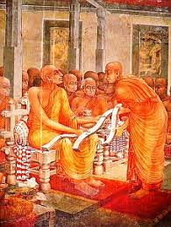
Palibodha
Palibodha means the cutting out of impediments.
Successful meditation needs a suitable environment, free from disturbing elements.
Buddhaghosa identifies 10 impediments which must be cut out before beginning meditation.

Slide 5
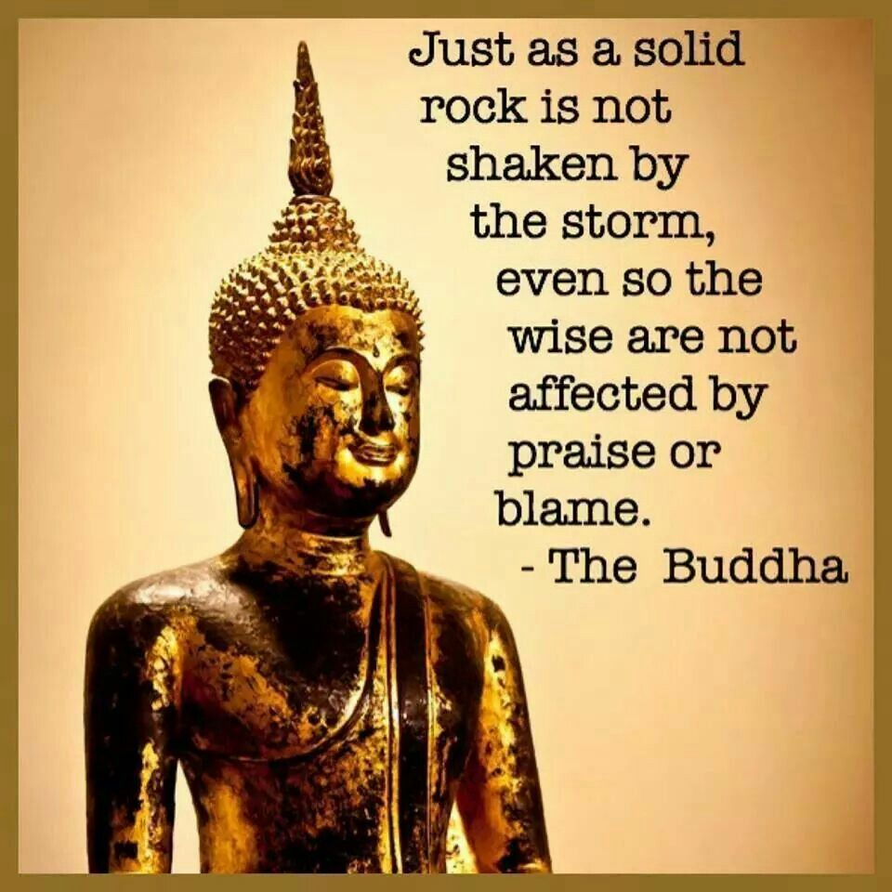
10 Impediments
Abode (avasa)
Family (Kula)
Gain (labha)
Group (gana)
Activities (kamma)
Travel (addhana)
Relations (jati)
Illness (abadha)
Study (gantha)
Supernatural Faculties (iddhi)

Slide 6
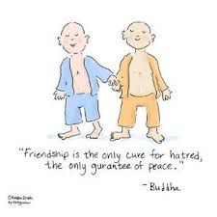
Kalyana Mitta
The Kalyana mitta is the search for a good friend or teacher.
In the process of meditation there occur all kinds of psychological and physical experiences which means you need the advice and support of someone who has been through the experience themselves.
Buddhist tradition says that the Buddha gave each newcomer a meditation topic suited to them. The kalyana mitta attempts to do the same.
In Buddhagosa’s work, he divides people up into 6 different personality type. Each has their own meditation topic

Slide 7
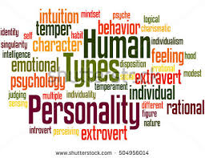
How a diagnosis is made
Buddhaghosa said that you can recognise different personality types by the way they eat, clean their room, react to certain signs.
But he also suggested that there are mixed types.
Knowing the personality can help to decide the focus for meditation.

Slide 8
Choosing suitable subjects
The Kalyana Mitta chooses the most suitable subjects for their student to meditate on based on personality:
1 Greed types should meditate on the asubha objects
2 Hate types should meditate on the Brahma-vihara
3 Delusion types should practice mindful respiration
4 Faith types should practice the recollections (anussati)
5 Intelligence types should recollect peace and death
6 Argumentative types should practice mindful respiration

