Slide 1
Tibetan Visualisation and Deity Yoga
In deity yoga one of the visualisations performed is:
Seeing one's body as the body of the deity
Seeing one's environment as the pure land or mandala of the deity
Perceiving one's enjoyments as bliss of the deity, free from attachment
Performing one's actions only for the benefit of others

Slide 2
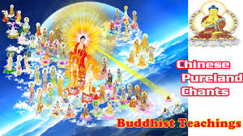
Pure Land - Chanting
Repeating for the name of Amitābha Buddha is traditionally a form of Mindfulness meditation.
This may be done vocally or mentally, and with or without the use of Buddhist prayer beads. Those who practice this method often commit to a fixed set of repetitions per day.

Slide 3
Pure Land - Visualisations
Another practice found in Pure Land Buddhism is meditative contemplation and visualization of Amitābha Buddha, his attendant bodhisattvas, and the Pure Land.
The basis of this is found in the Contemplation Sutra, in which the Buddha describes to Queen Vaidehi the practices of thirteen progressive visualization methods, corresponding to the attainment of various levels of rebirth in the Pure Land.
The first of these steps is contemplation of a setting sun, until the visualization is clear whether the eyes are open or closed.

Slide 4
Modern Mindfulness Meditation
Thich Nhat Hanh
Mindfulness is when you are truly there, mind and body together. You breathe in and out mindfully, you bring your mind back to your body, and you are there. When your mind is there with your body, you are established in the present moment. Then you can recognize the many conditions of happiness that are in you and around you, and happiness just comes naturally.

Slide 5
Zen
Zen is about living in the present with complete awareness.
Practitioners turn off the automatic pilot that most of us operate from throughout the day -- we don't really notice all the things that are going on around us or within our own minds.
They try to experience each moment directly. They don't let thoughts, memories, fears or hopes get in the way.
They practice being aware of everything they see, hear, feel, taste, and smell.

Slide 6
Zen
Another way of looking at this is to say that a Zen practitioner tries to be completely aware in the activity of any particular moment -- to the extent that they are one with what they are doing. So, for example:
when they eat they focus totally on the food and on the act of eating;
when they meditate they open the mind to the reality of the moment, not allowing thoughts, feelings or sensations to preoccupy them, not even thoughts about enlightenment or Buddhism;
when they work, they only work;
when they brush their teeth, that's all they do -- they don't think about other things at the same time.

Slide 7
Zen
Zen practice is to realise that thoughts are a natural faculty of mind and should not be stopped, ignored, or rejected.
Instead, thinking, especially discursive thinking, is to be acknowledged but then put to one side so that the mind is not carried away by worries, anxieties, and endless hopes and fears.
This is liberation from the defilements of the mind, the suffering of the mind, leaving the truth of this vast, unidentifiable moment plain to see.
http://www.bbc.co.uk/religion/religions/buddhism/customs/meditation_1.shtml

Slide 8
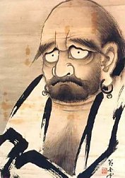
Wrong! the answer is 9.
There is no donut. You can only eat the hole.

