Slide 1
Engaged Buddhism
War and Conflict

Slide 2
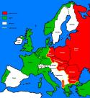
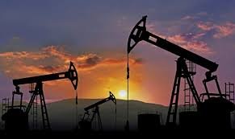
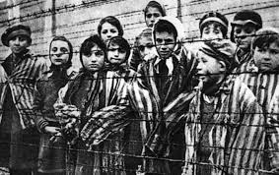
List 3 causes of war?
Make links to the 3 poisons?
The 4NT?
Whatever conflict arises, the sense of possession is the cause (Santideva, Mahayanist poet)

Slide 3
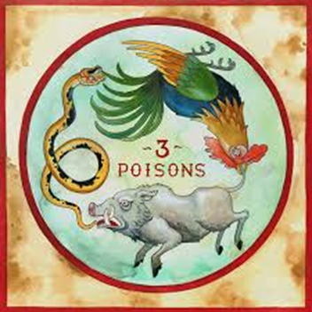
War – Apply what we have learned to War
Do you think Buddhism could support war?
What would be the Buddhist explanation for war?
What Buddhist teachings would argue against it?
Apply as many teachings as you can.

Slide 4
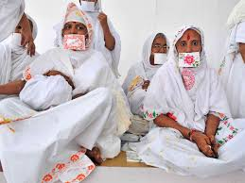
What about war?
No real Buddhist rationale for war
Ahimsa – links to social context of Buddha’s life
In common with Jains rejected animal sacrifice
(note -Disagreed with them about atman)
Precepts – do no harm
The Buddha said ‘conquer anger with love, evil by good, conquer stinginess by giving, conquer the liar with truth’

Slide 5
Other concepts to apply to war…
Compassion (karuna) - Particularly in Mahayana
Sunyata/interbeing
‘right livelihood’
First precept is the commitment to avoid harm
kamma
The 8 fold path certainly seems to aim at a world on non-violence based on wisdom and calmness
Always possible in the real world?

Slide 6
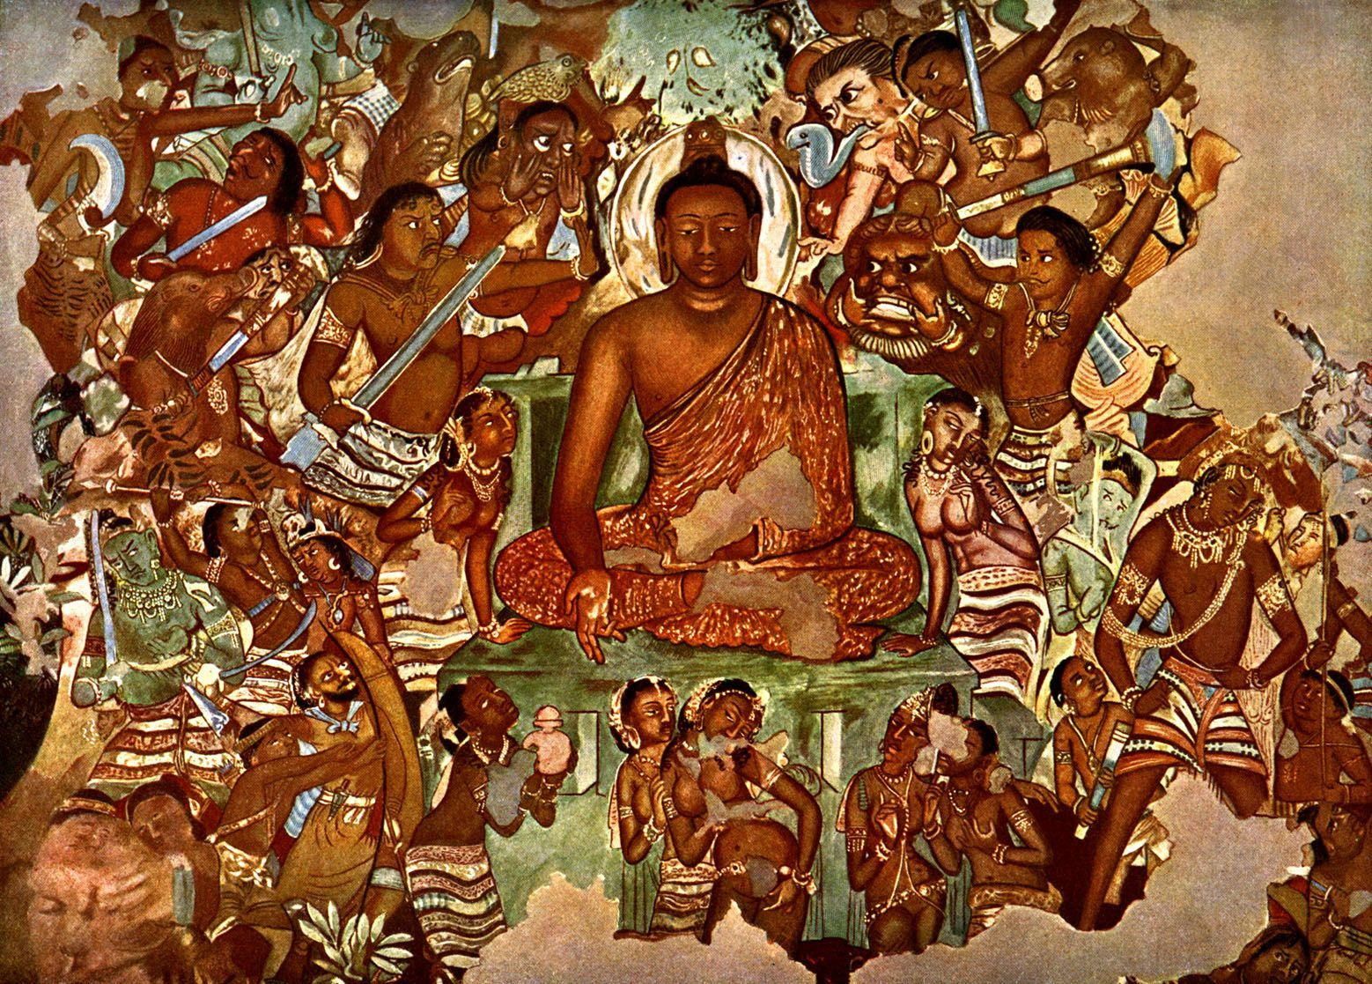
Pacifism ‘ideal’
Lay Buddhists may not always feel up to this ideal
The Buddha himself was tempted by Mara who encouraged him to be King
The Buddha saw that Kings are bound to sense desires – maybe impossible for someone to rule and be enlightened?

Slide 7
Previous lives….
In a previous life the Buddha recalled being a ruler
BUT no war necessary in the society he founded based on the precepts
Can rule according to the dharma if people are protected – e.g from poverty
Asoka – Indian Emperor widely regarded in Buddhism for social ethics, emphasis on non-violence, spread the dharma through discussion/negotiation and where possible avoided conflict
Real world – some UK Buddhists were conscientious objectors in wars, others considered it a duty to fight against fascism

Slide 8
Metta Bhavana
Metta Suttra
May all beings be happy and secure, may they be happy-minded.
Just as a mother would protect her only child at the risk of her own life, even so, cultivate a boundless heart towards all beings.
Let thoughts of boundless lovingkindness pervade the whole world: above, below and across, without obstruction, without any hatred, without any enmity.
How can we apply cultivation of metta bhavana (meditation and state of mind) to conflict and war?
What did Thich Nahat Hanh say in his interview about the importance of Metta in suppating Karuna?

Slide 9
Skilful Karmic Fruits?
There have been conflicts – Vietnam/Thailand/Sri Lanka that have involved Buddhists
Can a person use teachings on skilful karmic fruits to argue that conflict and violence is in fact necessary?
Example:
‘if we want to preserve our nation and religion we sometimes have to sacrifice rules for survival’
‘anyone who wants to gain merit should kill communists, the one who kills them will acquire great merit…if the Thai do not kill them, the communist will kill us’
Kiitivuddho, Thai monk, anti-communist, USA airforce bases in Thailand to bomb Communist areas in Vietnam
Discuss:
Is social Activism that is practiced intentionally and skilfully still a path towards good karma?
Challenge:
Link in Captain Compassionate to skilful karmic fruits
Discuss – what do you think of the above?

Slide 10
Dhammapada ‘Buddha’ quotes & others to use to summarise views & implications for war
There was a ‘special hell’ for those who fought in war – some texts argue even killing in self defence is wrong
‘conquer anger by love, evil by good, conquer the stingy by giving, conquer the liar by truth’
‘Whatever harm a foe may do to foe, or a hater to a hater, an ill directed mind can do one far greater harm’
Mahayanist writer - Santideva
‘anger at a fool for harming others is like anger at a fire for burning things’
‘if someone harms one look at it as the karmic results of similar harm one has done to others’
‘both his weapon and my body are the causes of my suffering. Since he gave rise to the weapon and I to the body, with whom should I be angry?’

Slide 11
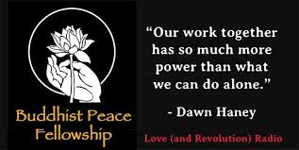
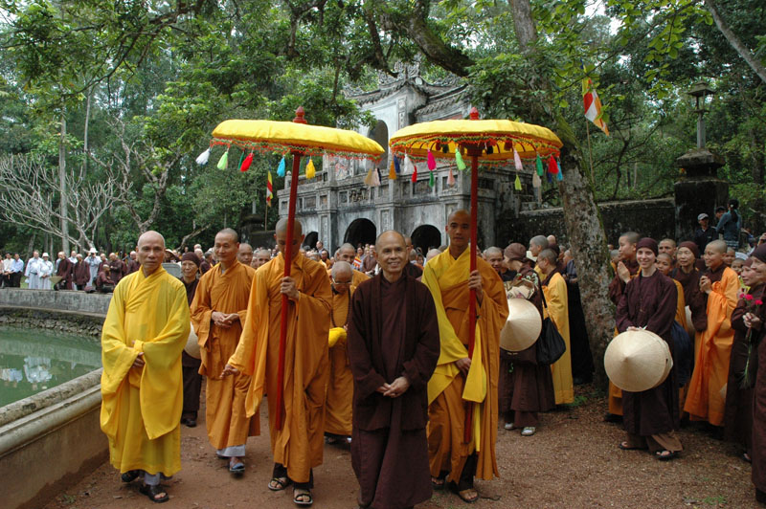
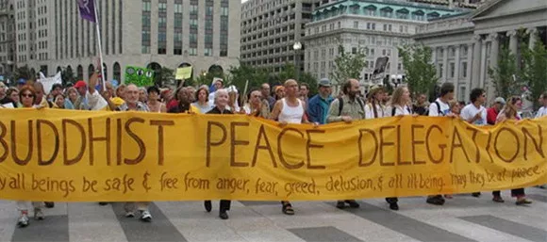
Social Activism – Peace Fellowship
Independent research – look at the ‘Buddhist Peace Fellowship’
Challenge task – see if you can find other examples

