Slide 1
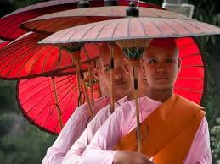
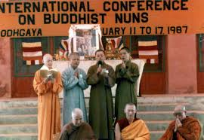
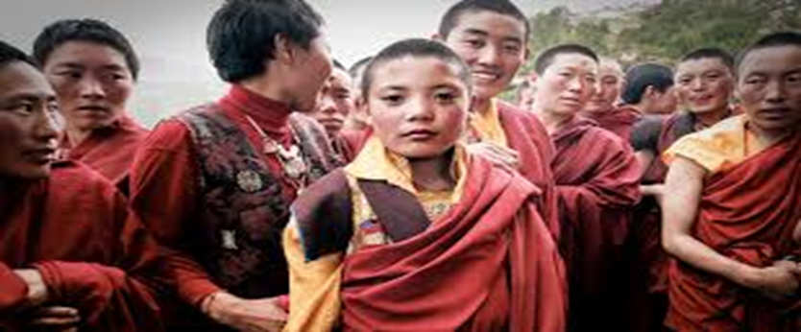
Women in Buddhism

Slide 2
Areas of Study:
1. To identify how women were viewed within the time of Buddha and by his followers
2. To discover some ideas of the early Nuns and how they formed
3. To look at modern Nun’s and how they view the teachings from a more feminist perspective
4. To research evidence particularly relevant to Thailand and the struggles of women nuns

Slide 3
The History of Women in Buddhism Thinker: Eva. K Neumaier
After Buddha realised enlightenment his followers simply imitated his Buddha’s way of life.
A lot was written down about this new situation and how women should behave within this new backdrop, namely how they should interact with lay people – rules on sexual and erotic activities
At the time compared with previous ideals in Indian culture this contested general views held at the time.
As Buddhism changed Indian culture women of the upper classes did began to enjoy opportunities in terms of intellectual and artistic talents (Horner)
In fact under the new founded Buddhism having a girl was no longer as feared.
“Under Buddhism more than ever before , she was an individual in command of her own life until the dissolution of the body, and less of a chattel to be the only respected if the she lived though and on a man”
No longer was she simply a vessel for children with none of her own destiny or value.

Slide 4
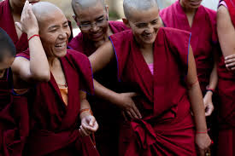
Did Buddhism change approaches to the role of women?
So Buddhism generally challenged the social beliefs of India at the time.
It could be read that “many of the rules specific to nuns’ order were obviously designed to minimise society’s discomfort with independent women, exempt from the reproductive routine and male supervision and outside the range of domestic duties.”
“At this time a lot of traditions had the opportunity to include women more than did any other religious group emerging as that time.”
Discuss:
Did Buddhism change the way women were treated and seen ?
Why was this a different approach?

Slide 5
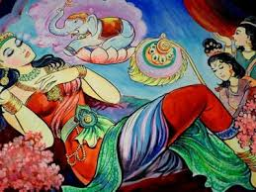
Women in the Early Life of the Buddha
The word of the Buddha makes up a large majority of what we know, however, they were written down a good 200 to 300 years after Siddhartha's death.
We do learn that Buddha’s birth is miraculous and his conception happens without defilement
She has a painless birth and it would seem that the impression is that his mother is a means to an end, her birthing a child isn’t important but the importance of him being born is.
It is said that his birth was unique and then his mother dies shortly after.
His mum’s sister Prajapati took over as wet nurse suggesting that the woman's role was some how replicable.

Slide 6
So on his journey to enlightenment did women figure?
Well we know at the point at which he nearly starved himself to death it was a woman the offered him a bowl of rice.
That night he experienced enlightenment
This female is seen as the embodiment of compassion and generosity.
Generally speaking in the written accounts Buddha tended to talk to women with typical ‘feminine’ issues such as husbands and the death of a child. He talks to the women with same compassion as he does with men.
There is no clear evidence of misogyny within the life story of Buddha
But there is also no mention of women as ‘persons of intellectual and spiritual potency equal to that of men.’

Slide 7
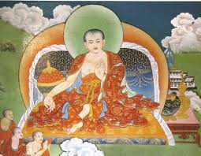
Ananda
Ananda was one of Buddha’s most attentive and loyal monks/followers.
At this point it was Ananda who after being persuaded by Prajapati (Siddartha’s former nanny) that a nun’s order would be desirable. At this stage Ananda then persuades Buddha.
It is stated though that Buddha feels that it would shorten the existence of pure Buddhism to less than a thousand years, implying that women were still a hindrance.
This has continued throughout both Therevadan and Mahayanan Buddhists, as mentioned by Rita Gross many feel Buddhism needs to modernise its view of women.
Buddha did admit that women were capable of achieving Nirvana, but stated Nun’s should follow 8 rules that generally inferred that they were subordinate to men.

Slide 8
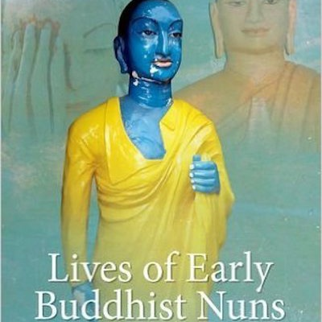
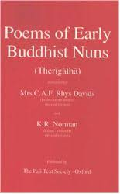
Early Buddhist Nuns
A lot of what we know is from a collection of poems which may give insight to the early nuns.
If you Read Songs of the Elder Nuns it does seem to suggest the early nuns felt they were largely equal to the monks.
What seems to be the case is that what mattered was the individual journey to enlightenment not the individual’s gender.
Different reasons for their choice to be nuns from just wanting to escape Samsara through to trying to find meaning after the death of a child.
Tended be people from the Upper Castes

Slide 9
Early Buddhist Nuns
Married and unmarried women in the early days, though largely unmarried.
They had to be debt free, parents permission and also free from social bondage.
It seems that being married had now been something not necessarily required of women at this time and in fact it was maybe normalised to go into the Order not following traditional women roles.
If women had children they were permitted close contact with them to care for them up until they reached puberty.

Slide 10
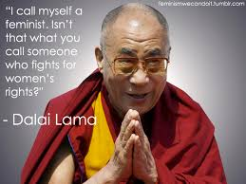
Does Modern Buddhism promote gender equality?
To Discuss:
How are women not shown equality within Buddhism
How are women treated equally in Buddhism?

Slide 11
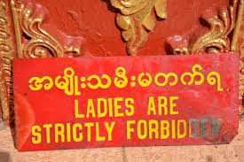
Nun’s in Thailand
Buddhist female monks in Thailand have struggled to achieve gender equality and have experienced threats and discrimination.
1. Click on the image and watch the clip and explain the issues they face
2. Scan the QR code and read the article and write 5 summative bullet points.

Slide 12
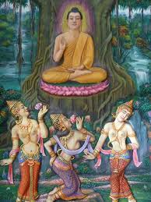
Negative Perceptions of Women in Buddhism
Mara’s daughters shown tempting the Buddha.
Though it had been made clear that women can achieve a religious goal the view that women are “sexual temptresses who embody ‘the limitations of the human condition, which is the continual process of suffering and rebirth’”
Mara the ruler of the realm of desires wanted to stop Buddha achieving enlightenment so she sent her 3 daughters Lust, Aversion and Craving to tempt the Buddha
This view of women still remains quite prevalent, that women will keep men enchained in the cycle of Samsara.

Slide 13
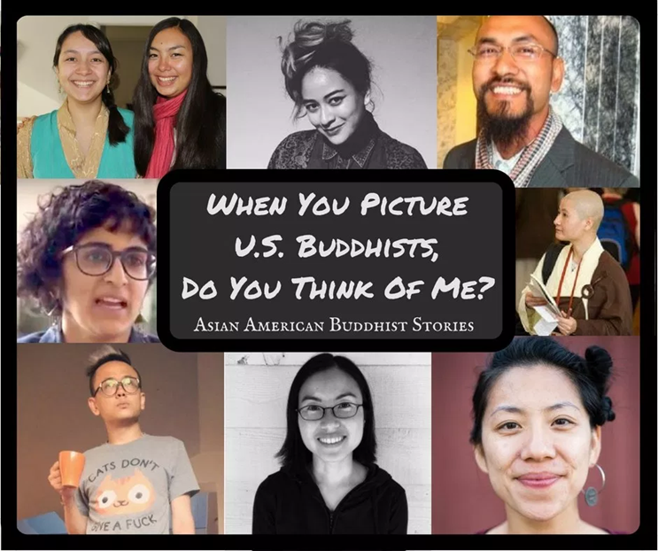
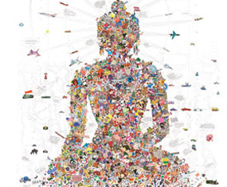
American Buddhist Women
There is still an imbalance in the roles and perception of women in Buddhism.
Although American Buddhist women take into account the history and general traditional views, they do tend to take a feminist stance.
As society has changed we should look to go beyond the teachings and focus on the aspect of impermanence, this idea that really there is no gender.
The feminist movement and rise of Buddhism in America happened at a similar time, so the way that Buddhism developed in America has been very different to some parts of Asia.
Equality is much more the status quo in American and western Buddhism as the religion merges with cultural influences – one of which is gender equality.

Slide 14
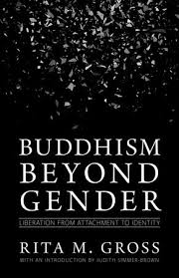
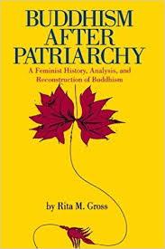
Thinker: Rita Gross
Female rebirth is necessary to have people in female bodies speak out against the injustice of patriarchy”
Professor Rita Gross is a Buddhist academic advocating gender equality.
She remains a faithful Tibetan Buddhist, but fearless in critiquing the human-made power structures of Buddhist institutions.
She speaks out against many aspects of gender discrimination and particularly the idea in Buddhism that female rebirth is seen in a negative light.

Slide 15
Female Buddhist Role Models
Tibetan Buddhism offers a unique premise: that to be a woman can actually be favourable on the path to spiritual realisation.
There are examples in ancient scripture of Female bringers of spiritual wisdom known as a Dakini.
10 Buddhist Women article:
Pick one to use as an example
Many female Buddhist see Tara as their role model and as a strong female figure to gain inspiration from

Slide 16
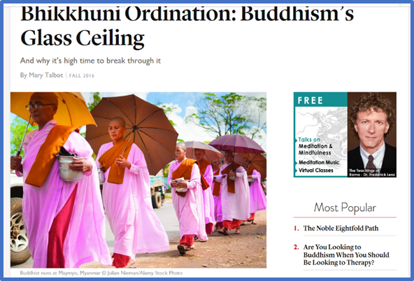
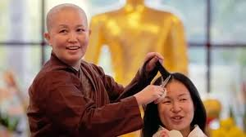
Bhikkhuni Ordination
Read the article: can you use this to explain the need and movment towards equality in Buddhism?
5 bullet points
Your evaluation

