Slide 1
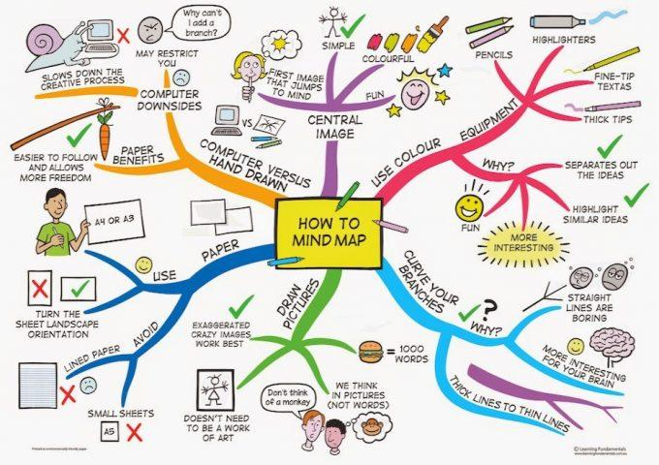
Year 8
Revision
Matters of Life and Death Assessment

Slide 2
Topics to Revise: Matters of Life and Death
Views on Personhood what characteristics make a person with human rights?
Abortion: opinions for and against
Pro Life and Pro Choice views
Religious views towards abortion
Euthanasia: opinions for and against
Religious views on Euthanasia
Treatment of animals and the environment

Slide 3
Rapid Recall!
1) What is the Law on abortion in the UK? | 2) When does a foetus heart start beating? | 3) What does conception mean?
4)What does the term Euthanasia mean? | 5) What is quality of life? | 6) What does sanctity of life mean to Christians

Slide 4
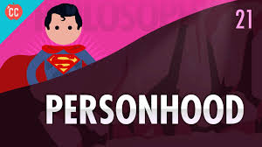
What is Personhood?
Being an individual person who is seen as unique and special that deserves human rights.
Notes:
Video up to 3.13

Slide 5
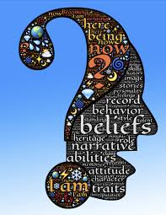
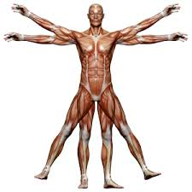
What makes you a person?
Task: Make a list or mind map of your ideas
What Makes You, You?
Challenge: Investigate what Christians think about humans being different to all other animals/life on earth
Top Philosopher: What might the Christian Bible quote ‘man is made in the image of God’ mean about how Christians see human as being special?

Slide 6
The Law on Abortion
Abortion is the termination of a pregnancy which is illegal in Britain unless:
The woman is less than 24 weeks pregnant and two Doctors agree that:
Having the baby would be a greater risk to the woman’s health than having an abortion
Or the woman’s family would suffer
2) At any stage of pregnancy two Doctors agree that:
Having the baby would be a risk to the woman’s life
Or the baby would be born with disabilities

Slide 7
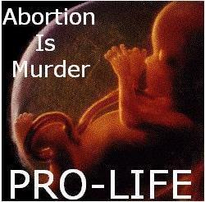
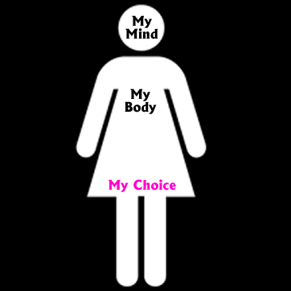
Abortion: Pro Life Vs. Pro Choice
Pro-choice is a term used to show support of the belief that women should have access and the right to abortions.
Pro-life is a term used to
Show opposition to
abortion, and support for
foetal rights.

Slide 8
Christian Views on Abortion: Roman Catholics
Catholics believe life begins at conception. Human life begins when an ovum is fertilised. This belief is known as ensoulment as this is when Catholics believe a person receives their soul.
‘You shall not murder’
-Exodus 20:13
‘Before I formed you in the womb I knew you, before you were born. I set you apart; I appointed you as a prophet to the nations’
- Jeremiah 1:5
Catholics believe life is sacred or holy and belongs to God therefore only God has the right to end a pregnancy. This is known as the sanctity of life.
Roman Catholics are Pro Life

Slide 9
Christian Views on Abortion: Church of England
Many Anglicans believe that abortion is wrong . However they accept that it should be allowed in some situations, as it would be the lesser of two evils.
This is view is based on Jesus' teachings and many feel in some situations allowing abortion is the most loving thing to do to prevent suffering.
‘Love your neighbour as yourself’
-Matthew 22:37-40
As well as this many Anglicans do not believe life begins at conception.

Slide 10
Euthanasia
From Greek meaning……
EUTHA= ‘Easy’ (sometimes translated as ‘good’)
NASIA= ‘Death
Sometimes a person’s quality of life is so poor they see no point carrying on their life so they want to be able to end their life.
Euthanasia is also known as assisted suicide and people who support euthanasia want to be given the help of a doctor to end their life
Quality of Life – the idea life must have some benefits to be worth living.

Slide 11
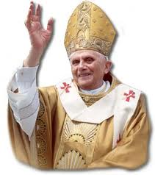
Christian Catholic Teaching on Euthanasia
The Catholic Church teaches that euthanasia is wrong
‘thou shall not kill’
They believe that only God can make life so only God can end a life.
All life is holy and special (sanctity of life) this means they do not support euthanasia.
Instead they think hospice care should make sure people with difficult or terminal illnesses are well cared for.

Slide 12
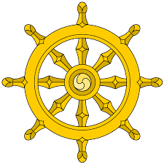
Religious Views towards Animals
Most Christians believe that animals do not have rights but think that humans should not be cruel to animals and that farmers should care for their animals.
Some Christians think animals can be used by humans as we are God’s most important creation.
This idea is called Dominion the idea that humans are in charge and can use animals and the environment as they want.
On the other hand, God appointed ‘man’ as Steward of the animals. This suggests we should look after them. It is called ‘stewardship’.
Some Christians may choose to become vegan or vegetarian.
Some Christians buy products like free range eggs to make sure animals are treated well.
Task
Which view do you most agree with and why?
Stretch Yourself: what do Buddhists think about eating meat and why?

Slide 13
What does ‘vegetarian’ and ‘vegan’ mean?
Vegetarian:
Someone who doesn’t eat meat. For moral or religious reasons, they believe killing animals is wrong
Vegetarians still use other animal products that don’t kill animals, such as milk, eggs and honey.
About 14% of British people identify as vegetarian.
Vegan:
Someone who stops using all animal products to reduce harm and cruelty to animals.
Vegans don’t eat meat, drink milk, use honey or wear any animal skins or fur.
About 3.5 million British people identify as vegan.

Slide 14
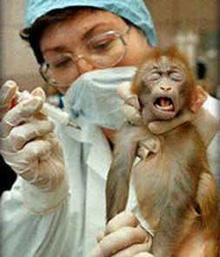
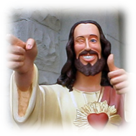
Animal testing
More than 2.7 million live animal experiments happen in the UK in 2002.
British law says that any new drug must be tested on at least two different species of live mammal.
Almost every medical treatment you use has been tested on animals.
Most Christians disagree the use of animal testing for reasons such as trying new make-up.
The Bible shows that animals are creations of God and therefore are important.
However, they believe it is ok in case of live saving drugs.

